Slide 1
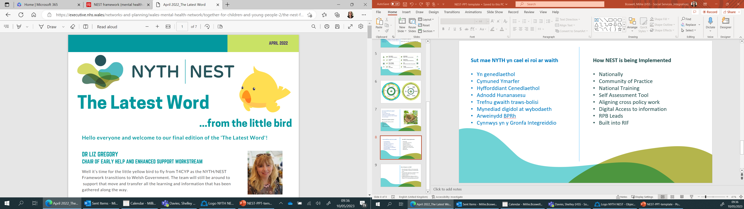

NYTH/NEST

Slide 2


Notes:
https://youtu.be/wYvU5t9vopI

Slide 3
Fframwaith NYTH/NEST, sef:
Dull gweithredu ‘system gyfan’ ar gyfer datblygu gwasanaethau iechyd meddwl, llesiant a chymorth i fabanod, plant, pobl ifanc, rhieni, gofalwyr, a’u teuluoedd ehangach
NYTH/NEST is:
‘Whole system' approach for developing mental health, well-being and support services for babies, children, young people, parents, carers and their wider families
Notes:
Planning tool for Regional Partnership Boards and wellbeing services.
Co-produced by the Together for Children and Young People (T4CYP2) network and a wide range of stakeholders.

Slide 4
Nod fframwaith NYTH/NEST yw:
Sicrhau ei bod yn bosibl gael mynediad at arbenigedd a chyngor yn gynt.
Rhoi i’r oedolion yr ymddiriedir ynddynt, ac sy’n agosaf at y plant, y sgiliau a’r hyder i ddeall sut y gallant helpu.
Gweithredu’n seiliedig ar ‘dim drws anghywir’
Darparu’r cymorth iawn ar yr amser iawn yn y ffordd iawn
NYTH/NEST aims to:
Make expertise and advice quicker to access.
Give the trusted adults closest to children the skills and confidence to understand what they can do to help.
‘No wrong door’ approach
Right Help at the Right Time in the Right Way.
Notes:
Broaden the conversation away from thinking that only specialist services can provide help.
Ehangu’r sgwrs mewn modd sy’n symud i ffwrdd oddi wrth feddwl mai dim ond gwasanaethau arbenigol sy’n gallu helpu.

Slide 5
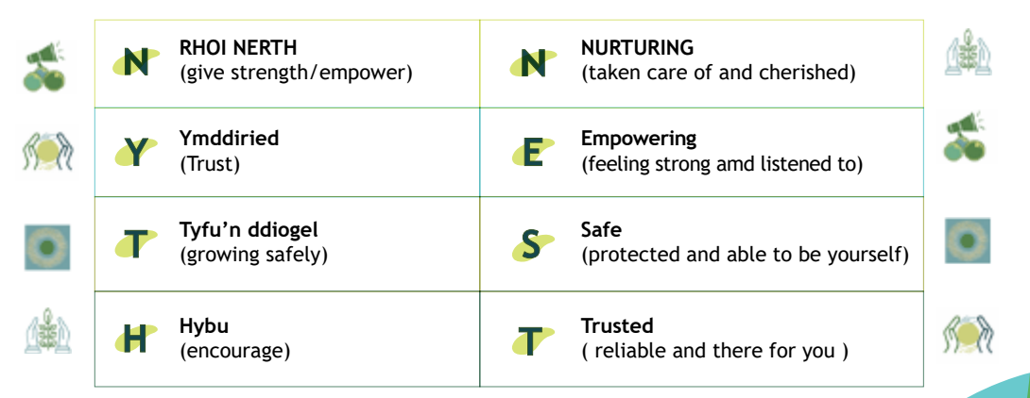

Slide 6
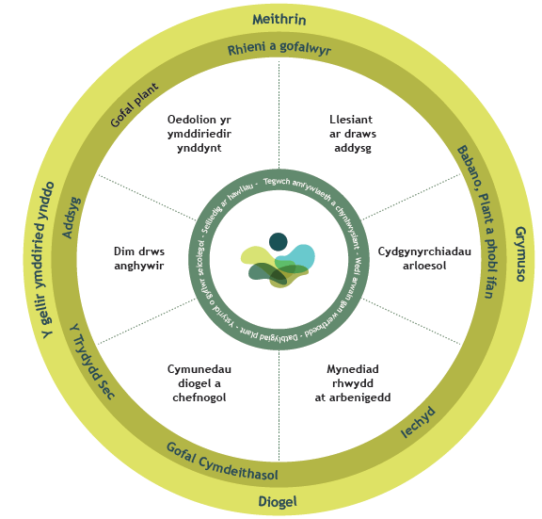
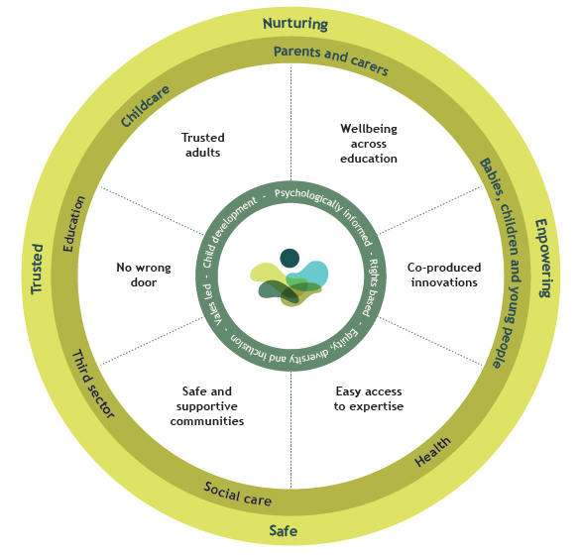

Slide 7
Oedolion yr ymddiriedir ynddynt
Mae oedolion yr ymddiriedir ynddynt yn gallu helpu drwy:
wrando a chydymdeimlo
helpu i ddod o hyd i eiriau ar gyfer emosiynau anodd
dangos ffyrdd o reoli anawsterau
helpu i ddatrys problemau
deall bod dicter weithiau yn ymwneud â phryder
Trusted adults
Trusted adults can help by:
listening and empathising
helping find words for difficult emotions
showing ways of managing difficulty
helping to sort out problems
understanding that anger can be about worry
Notes:
In NEST we recognise that it is really important for yp to build relationships with trusted adults, but this takes time and continuity.
Services are working to build the understanding of the important of trusted adults, for example in Powys the role of trusted adults is being built into job descriptions and staff supervision sessions. It is important there is support for trusted adults who care for babies, children and young people.
Trusted adults can:
focus on an individual’s strengths
encourage them to not give up
celebrate their achievements
provide the ‘everyday magic’ of a trusted relationship

Slide 8
Llesiant ar draws addysg
O’r crèche i’r feithrinfa, i’r ysgol, y chweched dosbarth ac ymlaen i’r coleg, mae lleoliadau addysg yn rhan fawr o fywydau babanod, plant a phobl ifanc.
Mae’n hanfodol bod ganddynt ddealltwriaeth dda o iechyd meddwl a llesiant a’u bod yn achub ar bob cyfle i’w cefnogi.
Wellbeing across education
From crèches, to nursery, to school, to sixth form and on to college, education settings are a big part of the lives of babies, children, and young people.
It is vital that they have a good understanding of mental health and wellbeing and take every opportunity to support it.
Notes:
Welsh Government have developed a range of initiatives to put mental health and wellbeing at the centre of education.
These developments also recognise that this is as important for teachers and support staff as it is for parents and carers too.
The NEST and 'whole school approach' frameworks emphasise the significance of mental health. They help all services work together to support it.
It is also important that other services work with education to make sure everyone is working together

Slide 9
Arloesi drwy gydgynhyrchu
Mae gan fabanod, plant a phobl ifanc yr hawl i’w barn gael ei chlywed a gweld camau yn cael eu cymryd o ganlyniad.
‘Dim byd amdanoch chi, heboch chi’.
Co-produced innovations
Babies, children and young people have a right to have their opinion heard and acted upon.
‘Nothing about you, without you’.
Notes:
This is according to the 'United Nations Convention on the Rights of the Child, Article 12'.
We expect services to stay focused on what matters most to children, young people and their families and keep on improving.
National participation standards
provide information in an accessible way
listen to what people have to say
feedback on how we make the decisions why

Slide 10
Mynediad rhwydd at arbenigedd
Mae fframwaith NYTH am sicrhau bod cymorth a chyngor arbenigol ar gael yn haws.
Mae angen i oedolion yr ymddiriedir ynddynt sy'n rhan o fywydau plant wybod ble i droi am help er mwyn gallu eu cefnogi.
Rydym am helpu oedolion i ‘ddal ymlaen’ pan fo modd, yn lle ‘atgyfeirio ymlaen’.
Easy access to expertise
The NEST framework wants to make expert help and advice more available.
Trusted adults in children’s lives need to know where to go for help so they can support them.
We want to support adults to ‘hold on’ to children when they can instead of ‘referring on’.
Notes:
This could come from a variety of sources:
helplines
a regular visit from a specialist to a school or youth service
multi-agency teams with mental health professionals
access to specialist advice
And, if specialist services are needed, we want to stop families being passed from service to service, and telling their story lots of times.

Slide 11
Cymunedau diogel a chefnogol
Mae fframwaith NYTH yn cydnabod bod llawer o wahanol bethau yn bwysig i iechyd meddwl a llesiant.
gwaith a mynediad at swyddi sy'n talu'n dda
lleoedd diogel i fyw
amser, lle a chaniatâd i chwarae a chymdeithasu
cyfleoedd i wneud ymarfer corff a chymryd rhan mewn chwaraeon
bwyd iach
gweithgareddau celf a hamdden
Safe and supportive communities
The NEST framework recognises that lots of different things are important to mental health and wellbeing.
work and access to jobs that pay well
safe places to live
time, space and permission to play and socialise
opportunities to exercise and take part in sport
healthy food
arts and leisure activities
Notes:
These are problems that can’t be ‘fixed’ in clinics. Their importance is often under-estimated when looking to improve mental health services.
We want those delivering mental health support to consider these factors. Where there are wider issues services should help to address and acknowledge them.

Slide 12
Dim drws anghywir
No Wrong Door
We want families to get the right help at the right time and in a way that is right for them.
Rydym am sicrhau bod teuluoedd yn cael y cymorth iawn ar yr adeg iawn ac mewn ffordd sy’n iawn iddyn nhw.
Notes:
Having 'extra, or specialist help' is an important part of the NEST framework. Families who seek support for a range of needs sometimes find that they have to navigate a very complex system. They may fall through gaps where there are no services to meet their needs. Sometimes they are on waiting lists for a long time and are then told they were waiting in the wrong queue, or have been knocking on the wrong door all along.
All services with a role in mental health and wellbeing need to come together to work out how best to meet the need. These services can be from health, education, social services or the third sector. All have something to offer depending on a family’s circumstances.
The more services listen to what families need, the more they can adapt and fill the gaps. Support services might focus on different issues or groups of children, but they can all work together to create a 'nest' around the child. 'No wrong door' helps establish what is working well in an area. It can identify the services needed and prevent the frustration of waiting on a list. This is important for families to know they are receiving the right type of help and support.

